Slide 1
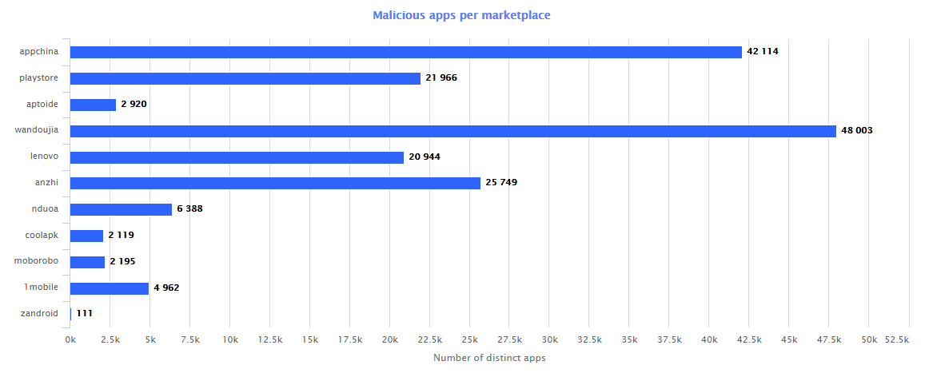
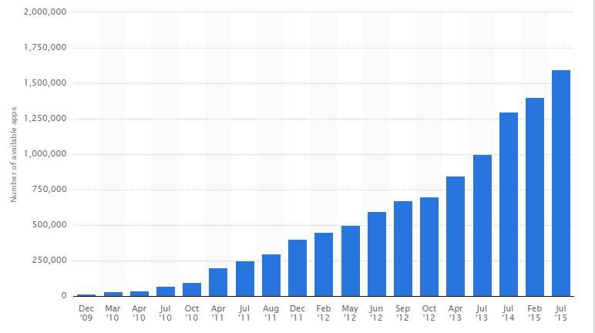

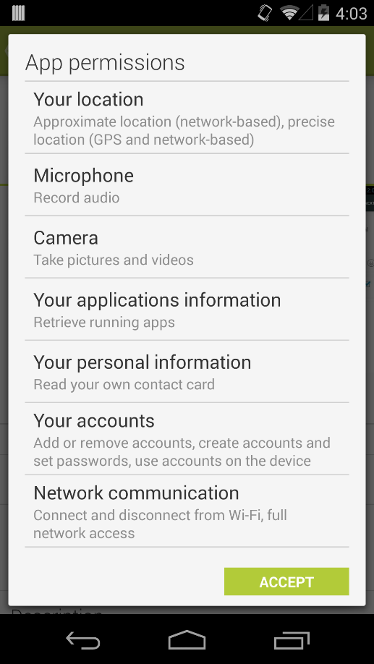

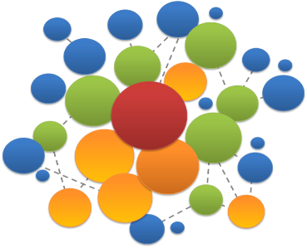



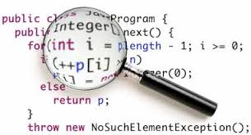

App data collected for 1,305,103
Stage 1: Data Collection
Stage 2: Feature generation from app descriptions, metadata and permission information
Stage 3: Using topic modeling and sys call analysis, detect potentially malicious apps
Image credit ADMIRE and STATISTA

